Slide 1
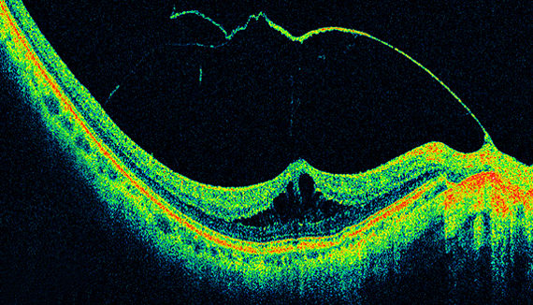
Research Dissertation Presentation
Adaptive Multi-Layer Fused Grad-CAM Architecture for Confident Retinal Disease Classification with Per-Scan Adaptive Explainability
Explainable AI for OCT-Based Retinal Disease Diagnosis
Student Names
Roll Numbers
[Student Name 1], [Student Name 2]
[Roll Number 1], [Roll Number 2]
Department
University
[Department Name]
[University Name]
Supervisor
[Supervisor Name]
May 2026
Domain: Medical Image Analysis, Explainable AI, CNNs

Slide 2
Navigation
Presentation Outline
1
Retinal Diseases
2
OCT Imaging
Overview of major pathological conditions
Gold-standard retinal imaging modality
3
Deep Learning in OCT
4
Existing CNN Models
CNN-based automated classification
Performance comparison and analysis
5
Can CNNs Be Trusted?
6
Black Box Problem
The trust vs. accuracy dilemma
Lack of interpretability in deep learning
7
Explainable AI (XAI)
8
Why Grad-CAM?
Making AI transparent and interpretable
CAM-based explanation methods
9
Limitations of Grad-CAM
10
Proposed Solution
Critical shortcomings in clinical use
Adaptive Multi-Layer Fused Grad-CAM
11
Validation Mechanism
12
Adaptive Fusion
Confidence-retention validation loop
Multi-layer dynamic weighting
Slides 13-18: Advantages, Conclusion, References, Q&A
Can AI become clinically trustworthy enough for real-world diagnosis?

Slide 3
Clinical Background
Retinal Diseases Overview
The Retina: Light-Sensitive Neural Tissue
The retina is a light-sensitive neural tissue layer at the back of the eye, consisting of photoreceptor cells (rods and cones) responsible for converting incoming light into neural signals. These signals travel through the optic nerve to the brain, enabling vision. Early detection of retinal diseases is critical to prevent irreversible blindness.
CNV
DME
Choroidal Neovascularization: Abnormal blood vessel growth beneath the retina causing leakage and vision distortion [1][2].
Diabetic Macular Edema: Fluid accumulation in the macula due to diabetes damaging retinal blood vessels [2].
Retina Anatomy
Photoreceptors, ganglion cells, bipolar cells, and RPE layers
Drusen
Normal
Yellow deposits: Lipid/protein accumulation between Bruch's membrane and RPE, associated with AMD [3].
Healthy retina: Normal retinal layers without pathological abnormalities or structural distortions.
OCT Disease Scans
Cross-sectional visualization of pathological features
Audience Question: What happens if tiny retinal abnormalities are missed during diagnosis?
Adaptive Fused Grad-CAM for Retinal OCT Analysis
Slide 3

Slide 4
Medical Imaging Technology
OCT Imaging and Medical Diagnosis
What is OCT?
OCT Cross-Sectional Scan
Optical Coherence Tomography (OCT) is a non-contact, high-resolution optical technique for micrometer-scale cross-sectional visualization of retinal structures [4][5]. It has become the gold-standard for retinal imaging diagnosis.
How OCT Works
1.
Infrared light emitted from source travels through beam splitter
2.
Divided into reference beam (reflected by mirror) and sample beam (to retina)
3.
Backscattered light recombines, producing interference signal
4.
Forms A-Scan (axial depth profile), combined into B-Scan (cross-section)
Clinical Workflow
Non-invasive
High-resolution
Clinically proven
Light Source
Retinal Scan
OCT Image
Diagnosis
Transition Question: If OCT scans are so detailed, can AI automatically interpret them accurately?
Adaptive Fused Grad-CAM for Retinal OCT Analysis
Slide 4

Slide 5
Artificial Intelligence
Deep Learning in OCT Analysis
CNN-Based Automated Classification Pipeline
OCT Scan
CNN Model
Feature Maps
Classification
Prediction
224×224 input
Feature extraction
Hierarchical patterns
4-class output
CNV/DME/Drusen/Normal
Key Capabilities
Performance Highlights
Automatic feature learning: CNNs learn hierarchical features from raw OCT images without manual feature engineering
ResNet50 on OCT-C8
99.90%
Pattern extraction: Detects subtle pathological patterns invisible to human observers
DenseNet121
93.35%
VGG19
97.54%
High accuracy: State-of-the-art models achieve 95-99% classification accuracy [1][2][6]
CNN models have achieved extremely high accuracies in retinal disease classification
Interactive Question: If models achieve 95-99% accuracy, should we fully trust their predictions?
Adaptive Fused Grad-CAM for Retinal OCT Analysis
Slide 5

Slide 6
Literature Review
Existing CNN Models and Performance
Performance Comparison on Retinal OCT Datasets
Model | Dataset | Accuracy | Key Notes
VGG16 | Shifa Eye Foundation | 71.9% | Baseline architecture [1]
VGG19 | Shifa Eye Foundation | 97.54% | With latent SMOTE [1]
ResNet50 | OCT-C8 / Custom | 75.6-99.9% | Residual connections [2][12]
InceptionV3 | Multi-dataset | 89.06% | Multi-scale features [19]
DenseNet121 | Retinal datasets | 93.35% | Dense connections [19]
CNN+Transformer | OCT-C8 | 98.0% | Lightweight hybrid [8]
Sources: [1] Ajmal et al. 2026, [2] El-Ghany et al. 2025, [8] Pan et al. 2025, [12] Vandersmissen & Oramas 2024, [19] Said et al. 2024
OCT2017 Dataset
Key Achievement
Critical Gap
Gold standard benchmark
State-of-the-art results
Despite high accuracy
84,484 OCT B-scans (CNV, DME, DRUSEN, NORMAL) collected by Shiley Eye Institute, UC San Diego [1][8][9]
Most models achieve >95% accuracy , with some approaching 99% classification accuracy on standard benchmarks
These models remain black boxes - clinicians cannot verify WHY predictions occur, limiting clinical deployment [9][10]
Transition: So why are these models still difficult to use in real clinical environments?
Adaptive Fused Grad-CAM for Retinal OCT Analysis
Slide 6

Slide 7
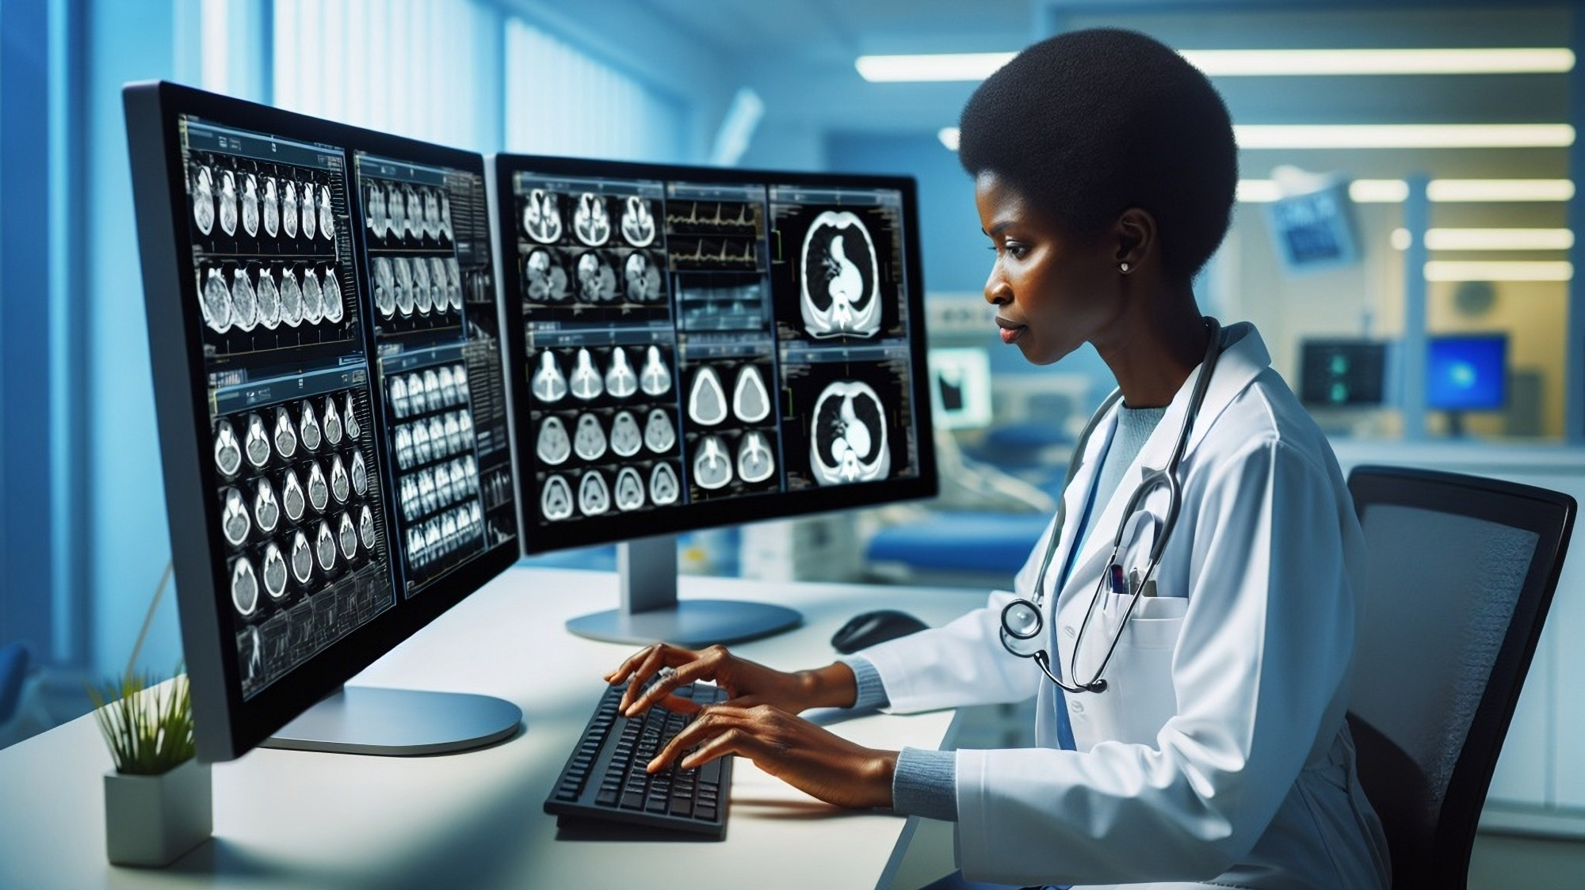
Critical Thinking
Can CNN Models Be Trusted in Medical Diagnosis?
The Trust Paradox
High accuracy alone is not enough in healthcare. Medical diagnosis requires transparency - doctors must understand WHY a prediction occurred. Incorrect reasoning with correct predictions is dangerous [9][10].
99% Accuracy
Clinical Trust
High Accuracy ≠ Clinical Reliability
Clinical Requirements
Verify decision-making aligns with medical knowledge
Dangerous Scenarios
Identify cases where correct predictions stem from incorrect reasoning
1.
AI predicts disease correctly but focuses on irrelevant regions
Meet FDA and regulatory requirements for transparency
2.
Clinicians cannot verify the reasoning process
Communicate diagnosis explanations to patients
3.
Model relies on dataset biases rather than true pathology
Audience Question: If an AI predicts blindness with 99% accuracy but cannot explain why - should doctors trust it?
Adaptive Fused Grad-CAM for Retinal OCT Analysis
Slide 7
This leads to the Black Box Problem in Deep Learning

Slide 8
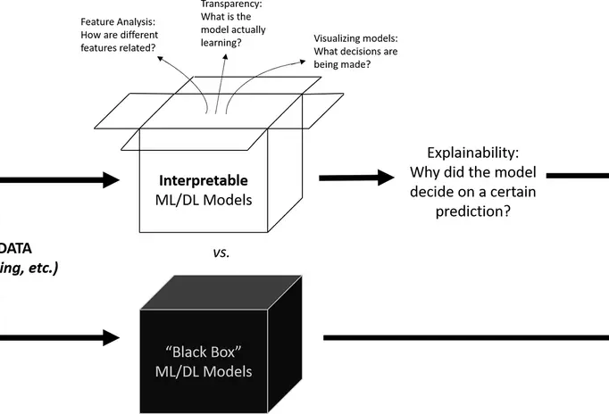
Fundamental Challenge
The Black Box Problem
What is the Black Box Problem?
CNNs provide predictions without reasoning. The internal decision-making process remains hidden, and clinicians cannot verify why a prediction occurred. This creates a fundamental lack of trust and interpretability [9][10].
OCT Image
???
"CNV"
Input
Hidden Process
Prediction
Deep learning behaves like a "black box"
Black Box AI Concept
Key Issues
Clinical Impact
Input data enters, prediction exits, but the internal reasoning remains opaque and uninterpretable
No reasoning provided
Cannot verify diagnosis
Hidden decision layers
Risk of wrong reasoning
Unverifiable predictions
Regulatory barriers
Hidden Layers
Lack of clinical trust
Patient safety concerns
Multiple convolutional layers extract features but don't explain their decisions
Interactive Prompt: What if AI highlights the wrong retinal region but still predicts correctly?
Adaptive Fused Grad-CAM for Retinal OCT Analysis
Slide 8

Slide 9
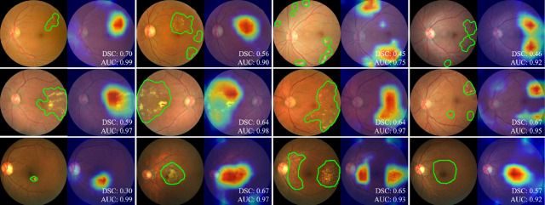
Solution Approach
Explainable AI (XAI)
What is XAI?
Explainable AI (XAI) converts black-box systems into interpretable systems. It helps visualize model reasoning and improves clinical trust and transparency [9][10].
CNN Model
Heatmap
Explanation
XAI: From Black Box to Transparent AI
Retinal Heatmap Examples
Grad-CAM highlights diagnostic regions: CNV (subretinal areas), DME (macular fluid), Drusen (perifoveal deposits) [2][6]
How XAI Works for Retinal Imaging
XAI identifies retinal regions influencing prediction by generating heatmaps over input images. These heatmaps highlight areas that significantly contribute to the model's decision [2][6][9].
XAI Benefits in Healthcare
Clinical validation of AI decisions
Error detection in model reasoning
Visual Evidence
Clinical Trust
Regulatory compliance (FDA)
Patient communication
Transition Question: How can we visualize what the CNN is actually looking at?
Adaptive Fused Grad-CAM for Retinal OCT Analysis
Slide 9

Slide 10
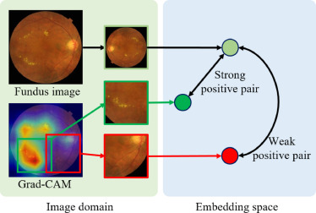
XAI Methods
CAM-Based XAI Methods
Family of CAM-Based Methods
Method | Approach | Key Feature | Clinical Use
CAM | Global average pooling | Class-specific weights | Limited
Grad-CAM | Gradient-weighted | Uses gradients as weights | Widely Used
Grad-CAM++ | Weighted gradients | Better localization | Moderate
Score-CAM | Score-based | Gradient-free | Emerging
LayerCAM | Layer-wise | Multi-layer extraction | Moderate
Eigen-CAM | Eigenvalue decomposition | Principal components | Limited
XGrad-CAM | Extended gradients | Improved sensitivity | Limited
Sources: [10] Persada et al. 2026, [12] Vandersmissen & Oramas 2024
Why Grad-CAM?
Most widely used in medical imaging
Lightweight - minimal computational overhead
Easy CNN integration - works with any architecture
Clinically interpretable heatmaps
Strong performance in retinal imaging [2][6][9]
Adaptive Fused Grad-CAM for Retinal OCT Analysis
Slide 10
Grad-CAM Principle
Uses gradients of predicted class scores with respect to feature maps to indicate spatial importance [10]
Interactive Prompt: Does highlighting regions automatically mean the explanation is reliable?

Slide 11
Problem Analysis
Limitations of Standard Grad-CAM
1
Coarse Spatial Resolution
2
Poor Boundary Localization
Last convolution layer outputs 7×7 feature maps. Upsampling to 224×224 requires 32× bilinear interpolation , producing smooth, blurry results [10][12].
Heatmaps show model's attention , not actual pixel-wise segmentation . Cannot guarantee pixel-level accuracy [10][15].
Problem: 49 spatial regions → interpolation obscures true localization
Problem: Unrealistic attribution, fails for precise tissue localization
3
Noisy Heatmaps
4
No Quantitative Validation
Standard Blurry Grad-CAM
Gradients are sparse by nature. Explanations are coarse due to upsampling of very small feature maps [10][12].
No mechanism verifying highlighted regions are truly diagnostic. Heatmaps are post-hoc visualizations without guarantees [10][15].
Coarse heatmaps with poor boundary localization and noisy activations
Problem: "Halo" artifacts around diagnostic features
Clinical Impact
Problem: Cannot assess clinical relevance of explanations
Cannot verify diagnosis
Missed small lesions
5
Weak Clinical Reliability
False confidence
Standard Grad-CAM provides no guarantee of diagnostic relevance. Clinicians cannot verify if highlighted regions actually caused the prediction, creating a critical clinical explainability gap [9][10][14].
Spatial-Semantic Trade-off
Deep layers maximize semantic content but sacrifice spatial precision
Transition: So how can we improve both explainability and diagnostic trust?
Adaptive Fused Grad-CAM for Retinal OCT Analysis
Slide 11

Slide 12
Novel Architecture
Proposed: Adaptive Multi-Layer Fused Grad-CAM
Core Innovation
Extract Grad-CAM from multiple CNN layers (Layers 2, 3, and 4 of ResNet50) where different layers capture different information. Combined with confidence-retention validation and adaptive fusion weighting for per-scan explainability.
L2
Layer 2
L3
Layer 3
L4
Layer 4
28×28 feature maps
14×14 feature maps
7×7 feature maps
Fine geometric details - Sharp boundaries, local texture, geometric precision information critical for disease localization
Mid-level patterns - Intermediate structures, shapes, and patterns at medium resolution
Semantic understanding - High-level structures, class patterns, and global context
Complete Architecture Flow
Input OCT
Multi-Layer Grad-CAM
Validation
Adaptive Fusion
Final Heatmap
Key Innovation: Per-scan adaptive explainability - weights dynamically computed for each individual scan
Adaptive Fused Grad-CAM for Retinal OCT Analysis
Slide 12

Slide 13
Validation Mechanism
Confidence-Retention Validation
Core Validation Concept
Validation Pipeline Visualization
Answer the critical question: "Is the highlighted region actually responsible for the prediction?"
Original Image
Validation Pipeline
Full OCT scan
1
Convert Grad-CAM heatmap to binary mask (threshold = 0.5)
2
Apply mask to original image (keep only highlighted regions)
Grad-CAM Heatmap
Highlighted regions
3
Re-feed masked image through CNN
4
Measure confidence retention score
Binary Mask
Threshold > 0.5
0.92
0.65
0.15
High retention - region contains diagnostic evidence
Medium retention - partial diagnostic evidence
Low retention - region is irrelevant
Masked Image
Only highlighted regions
Re-Prediction
Confidence score
Mathematical Formulation
rℓ = P(predicted class | masked image with Mℓ)
Where rℓ is the retention score for layer ℓ
Adaptive Fused Grad-CAM for Retinal OCT Analysis
Slide 13
Interactive Question: What if removing highlighted regions completely changes model confidence?

Slide 14
Fusion Mechanism
Adaptive Multi-Layer Fusion
Dynamic Fusion Mechanism
Fusion Heatmap Visualization
Multiple Grad-CAM layers are fused dynamically with adaptive weights. Each layer receives weight based on its confidence retention score. Stronger diagnostic layers dominate the fusion.
L2
33.3%
L3
44.4%
Weight Computation
wℓ = rℓ / Σrℓ′
L4
22.2%
Normalized retention scores ensure weights sum to 1.0
Mathematical Properties
Fused Heatmap
Non-negativity
Normalization
Monotonicity
Spatial precision + semantic understanding
wℓ ≥ 0
Σwℓ = 1.0
rℓ1 > rℓ2 → wℓ1 > wℓ2
Example: Adaptive Weights
Fusion Equation
Layer 2 (r=0.60)
33.3%
Lfused = w2·L2 + w3·L3 + w4·L4
Layer 3 (r=0.80)
44.4%
Layer 4 (r=0.40)
22.2%
Adaptive Weighting Benefit
Layer 3 dominates - mid-level patterns are most diagnostic for this scan
Automatically identifies which feature scale matters most for each individual scan
Adaptive Fused Grad-CAM for Retinal OCT Analysis
Slide 14

Slide 15
Comparative Analysis
Advantages of Proposed Method
Standard Grad-CAM vs Adaptive Fused Grad-CAM
Dimension | Standard Grad-CAM | Adaptive Fused Grad-CAM
Spatial Precision | 32× interpolation | Mixed 8×, 16×, 32×
Boundary Localization | Smooth blurry | Sharp precise
Noise Reduction | No validation | Artifact elimination
Quantitative Validation | None | Confidence-retention loop
Clinical Trust | Visualization only | Verified explanations
Adaptive Explainability | Fixed weights | Per-scan dynamic
Sharper Localization
Better Interpretability
Enhanced Trust
Improved from ±40 pixels to ±15 pixels precision through multi-resolution feature extraction
Clinicians receive explicit evidence that highlighted regions are diagnostically relevant with confidence scores
Adaptive weighting ensures most diagnostic layers dominate, reducing noise and improving clinical reliability
Adaptive Fused Grad-CAM for Retinal OCT Analysis
Slide 15

Slide 16
Summary
Conclusion
1
OCT + CNN Power
2
Grad-CAM Limitations
OCT + CNN enables powerful retinal disease classification achieving 95-99% accuracy on standard benchmarks
Standard Grad-CAM has major clinical limitations: coarse resolution, poor boundaries, noise, and lack of validation
3
Proposed Solution
4
Validation Impact
Adaptive Multi-Layer Fused Grad-CAM improves explainability through multi-resolution feature extraction and dynamic fusion
Confidence-retention validation improves reliability by proving highlighted regions contain diagnostic evidence
5
Clinical Significance
Adaptive fusion improves diagnostic trustworthiness by dynamically weighting layers per scan, ensuring clinicians receive verified, precise explanations
This framework aims to bridge the gap between high-performance AI and clinically reliable explainability
Final Question: Can explainable AI become the future standard for trustworthy medical diagnosis?
Adaptive Fused Grad-CAM for Retinal OCT Analysis
Slide 16

Slide 17
Bibliography
References
[1] M.M. Ajmal et al., "Deep learning based eye disease classification using OCT images," Experimental Eye Research, 2026.
[11] P. Mani et al., "Comprehensive dual framework for lesion segmentation and classification," Neural Computing and Applications, 2025.
[2] S.A. El-Ghany et al., "Automated eye disease diagnosis using 2D CNN with Grad-CAM," Symmetry, 2025.
[12] B. Vandersmissen and J. Oramas, "On the coherency of quantitative evaluation of visual explanations," Computer Vision and Image Understanding, 2024.
[3] D. Oncel et al., "Drusen morphometrics on OCT in eyes with AMD," Graefe's Archive, 2023.
[13] A. Beuse et al., "Automated detection of central retinal artery occlusion using OCT imaging via explainable deep learning," 2024.
[4] M. Zeppieri et al., "OCT: A brief look at uses and technological evolution," Medicina, 2023.
[14] W. Al-Dolat et al., "Enhancing fundus image analysis for diabetic retinopathy using CheXNet with CBAM and Grad-CAM," 2024.
[5] A. Mokhtari et al., "A survey on OCT technology and application," Bioengineering, 2025.
[15] A. Yavari et al., "Applicability study of AI attribution methods for ophthalmic image classification," 2024.
[6] S. Baba et al., "Retinal disease classification using custom CNN from OCT images," Procedia Computer Science, 2024.
[16] M.A. Farhad et al., "Enhanced lesion localization and classification in ocular tumor detection using Grad-CAM," IEEE Access, 2025.
[7] C. Photiou et al., "Extracting morphological features from OCT images," Photonics, 2023.
[17] N. Sengar et al., "EyeDeep-Net: a multi-class diagnosis of retinal diseases using deep neural network," Neural Computing and Applications, 2023.
[8] H. Pan et al., "A lightweight model for retinal disease classification," Biomedical Signal Processing and Control, 2025.
[18] Q. Jiang et al., "HyFormer: a hybrid transformer-CNN architecture for retinal OCT image segmentation," Biomedical Optics Express, 2024.
[9] M.D. Giammarco et al., "Explainable retinal disease classification through CNN," Image and Vision Computing, 2025.
[19] Z. Said et al., "Towards interpretable diabetic retinopathy detection: Combining multi-CNN models with Grad-CAM," IJACSA, 2024.
[10] A.G. Persada et al., "A review of CAM-based visual explanation on diabetic retinopathy," IEEE Access, 2026.
[20] M. Saito et al., "Grad-CAM-based investigation into acute-stage fluorescein angiography images," Journal of Clinical Medicine, 2024.
Adaptive Fused Grad-CAM for Retinal OCT Analysis
Slide 17
All references follow IEEE citation format. Full bibliography available in dissertation document.

Slide 18
Thank You
Questions & Discussion
Contact Information
Full Dissertation
[Email Address]
Available upon request
[Department, University]
May 2026
Bridging the gap between high-performance AI and clinically reliable explainability
Adaptive Fused Grad-CAM for Retinal OCT Analysis
Slide 18

